Slide 1

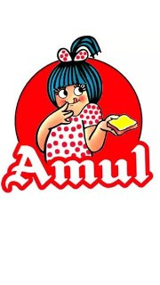

Amul
TheTaste of India
Presented by
Y. Manasa W akhila M.deepika
K. Sathvika
T. Karunasri

Slide 2

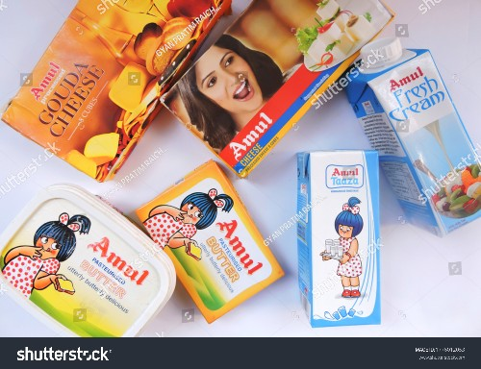
Introduction
Amul is an acronym (Anand Milk Union Limited) of the Indian cooperative society named Gujarat Milk Marketing Federation based in Anand, Gujarat. It is under the ownership of Gujarat Cooperative Milk Marketing Federation Limited, Department of Cooperation, Government of Gujarat. It is controlled by 3.6 million milk producers.

Slide 3
Trade name | Amul Coop
Type | Cooperative
Industry | Dairy
Founded | 14 December 1946; 76 years ago
Founder | Tribhuvandas Patel
Headquarters | Anand, Gujarat, India
Area served | Worldwide
Key people | Jayen Mehta (managing director)
Products | Milk products
Revenue | ₹52,000 crore (US$6.5 billion) (2022)
Owner | Dairy Producers of Gujarat
Number of employees | 1,000 (officers and employees) 3.6 million (milk producers)
Divisions | Banas Dairy Dudhsagar Dairy
Website | amul.com

Slide 4

Amul’s digital marketing strategies have effectively utilized various online platforms to engage with their audience.
Digital marketing strategy used by amul
Through social media channels like Facebook, Instagram, and Twitter, Amul has created a strong online presence and interacted with consumers in a personalized and engaging manner.

Slide 5
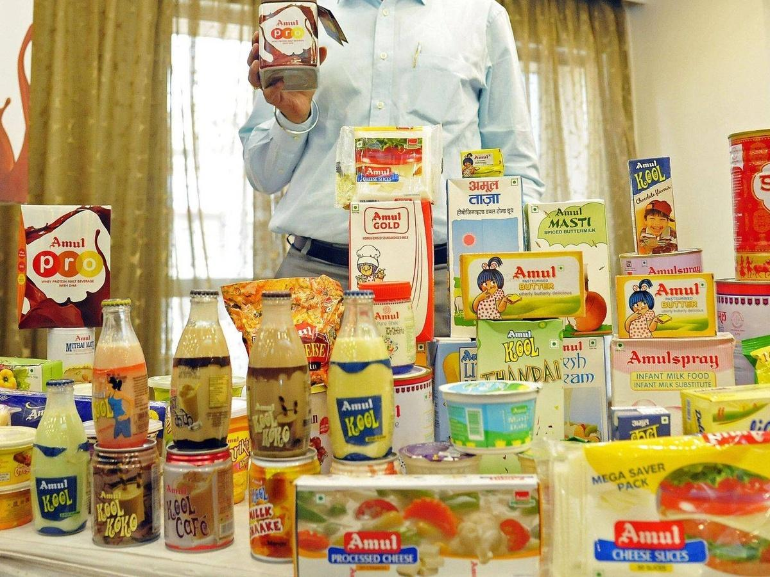
Brand products
Amul Buttermilk . Amul Lassi . Amul Immunity Shots . Amul Tru . Amul Cheese Spread . Amul Choco Buttery Spread . Amul Dahi Tikki . Amul French Fries . Amul Paneer Nuggets . Amul Premium Dahi . Amul Camel Milk . Amul Fresh Paneer . Amul Cheese Sauce . Amul Chocominis . Amul Bindaaz . Amul Sugar-Free Dark Chocolate . Amul Almondo . Amul Rabri . Amul Khoa Mawa . Amul Rasmalai . Amul Panchamrit.

Slide 6
Amul mission and values
Mission:“ Amul's mission is to provide remunerative returns to the farmers and to serve the interest of consumers by providing quality products that give value for money.
"Values: Cooperative Principles: Amul operates on cooperative principles, emphasizing democratic decision-making, equitable distribution of benefits, and member participation.Quality: Amul is committed to providing high-quality dairy products that meet or exceed consumer expectations.Transparency: The organization values transparency in its operations, financial dealings, and reporting to its members and stakeholders.Integrity: Amul upholds integrity in all its business activities and maintains ethical standards in dealing with farmers, customers, and partners.Innovation: Amul constantly seeks innovative solutions to improve production processes, product development, and market strategies.Sustainability: The company strives for sustainable .These mission and values have helped Amul become a successful and well-respected dairy brand in India.

Slide 7
Brand tone and identity
Brand Tone:friendly and Approachable: Amul's brand tone is friendly and approachable, making it relatable to a broad audience. They use humor and wit in their advertising campaigns, which often feature the beloved "Amul Girl" cartoon.Witty and Creative: The brand is renowned for its creative and humorous topical advertisements that comment on current events, trends, and cultural moments. This approach adds an element of creativity and cleverness to their communication.Youthful and Energetic: Amul's tone is often youthful and energetic, appealing to a wide range of age groups. This energy is reflected in their advertisements and marketing materials.
Brand identity:Logo: Amul's brand identity prominently features its iconic red and white logo with the name "Amul" written in bold, friendly, and easily readable fonts. The brand's logo is widely recognized across India.Mascot - Amul Girl: The Amul Girl, a cartoon character, is a vital part of their brand identity. This mascot is used to convey witty and creative messages in their advertisements, making them stand out.Colors: The brand predominantly uses red and white colors in its logo and branding, which symbolize energy and purity.Quality and Trust: Amul's brand identity emphasizes quality and trust. They have built a reputation for delivering high-quality dairy products to consumers.Indian Heritage: Amul's brand identity proudly reflects its Indian heritage.

Slide 8
Amul smart goals and KPI’s
1. Increase Market Share:Goal: Increase market share in the dairy industry.KPI: Percentage increase in market share within the next year.
2. Improve Customer Satisfaction:Goal: Enhance overall customer satisfaction.KPI: Net Promoter Score (NPS) improvement, based on customer surveys.
3. Expand Product Line:Goal: Introduce new dairy products or variants.KPI: Number of new products launched and their contribution to revenue.
4. Enhance Supply Chain Efficiency:Goal: Optimize supply chain operations for cost savings.KPI: Reduction in logistics costs, decrease in order processing times, or inventory turnover ratio improvement.
5. Sustainability Initiatives:Goal: Implement sustainability practices

Slide 9
Amul brand study
*Amul Brand Study:*Amul is an Indian dairy cooperative that has a strong brand presence. It is known for its wide range of dairy products. The brand study would include an analysis of the following:
1. *History and Evolution*
2. *Brand Identity*:
3. *Product Range*
4. *Marketing and Advertising*
Competitor Analysis:*Amul faces competition in the dairy and dairy-based products industry. Key competitors might include Nestlé, Mother Dairy, Britannia, and local dairy producers. In a competitor analysis, you would look at:
1. *Product Portfolio*
2. *Market Presence
3. *Pricing Strategies*
4. *Brand Strengths and Weaknesses*:

Slide 10
Buyer’s/audiance’s persona
1. *Households*
2. *Food Industry*
3. *Children and Youth*:
4. *Health-Conscious Consumers
5. *Urban and Rural Markets*

Slide 11
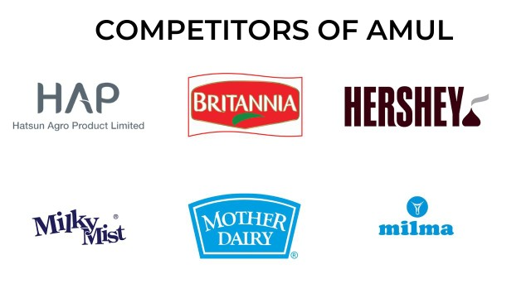
Brand competitor
The top competitors of Amul (GCMMF) include Akshayakalpa, Godrej Agrovet, Milky Mist, Dodla Dairy and Milk Mantra.britania, Nestle mother dairy, milkymist etc.Amul (GCMMF) has 273 active competitors. ranked by Tracxn score: Akshayakalpa - Tiptur based, 2010 founded, Series B company.

Slide 12
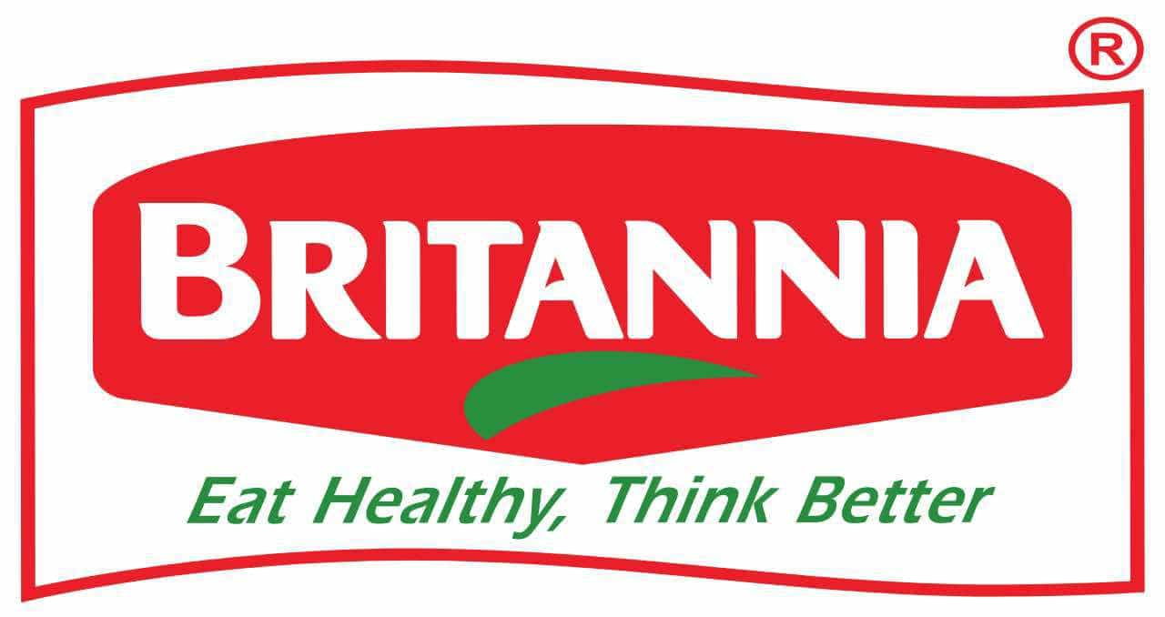
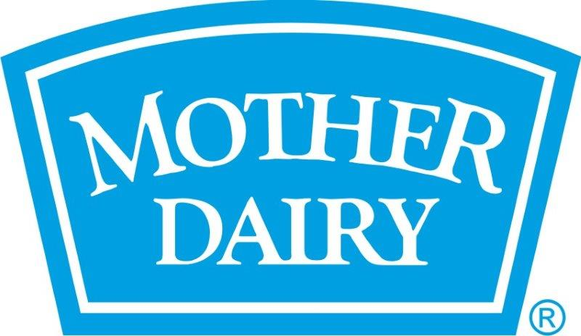

Marketing strategy of Britannia and social media campaigns are more focused on connecting taste, nutrition, and moments of life.
marketing strategy of Mother Dairy – a brand that not only nourishes India with wholesome dairy products but also uplifts rural communities through direct sourcing from village-level farmers.
Marketing Strategy of Hershey's analyzes the brand with the marketing mix framework which covers the 4Ps (Product, Price, Place, Promotion). These business strategies, based on Hershey's marketing mix, help the brand succeed in the market.

Slide 13
Search engine optimization for Amul
Amul always tried to provide their products at the best price. Its presence in every nook and corner has made it approachable in each house. They have not invested too much on Television advertisements. Rather they now prefer to use social media for their promotion and increase their presence. The brand actively uses two major social media platforms Facebook and Twitter.
Recently it has used great graphics and videos for the Rio Olympics 2016.

Slide 14
Competitors swot analysis
Sol.no | Competitors company | strengths | weakness | Opportunities | threats
1. | Hershey’s | A strong brand name , a strong image , good product diversification, one of the largest candy companies in the United states | Focus primarily on US market , not enough distributors. | Expand product line , expand into other countries, create more health conscious products | Nestle and mars, low international market share

Slide 15
Sol.no. | Companies name | strenghts | weakness | opportunities | threats
2 | Mother dairy | The major strengh of the mother dairy is the different variety of milks and a recognised brand name . 62% market share in delhi NCR region | Scarce mother dairy outlets ,less margin given to the outlet owners to match the existing competiors . | The is a scope of business as there is a demand for dairy products , dairy should open more outlets to get maximum advantage of the demand . | Increasing competition from the other brands , strong supply chain management by the competitors.

Slide 16
Sol.no | Company name | strenghts | weakness | opportunities | threats
3 | britannia | Brand port folio, excessive brand recall ,benefitting indian markets, penetration into the market, market leader in bakery | Over dependence on biscuit business, no overseas presence, dairy business struggle. | Upcoming dairy products, demanding healthier products, enter foreign markets, e- commerce. | Increasing competition , increasing price of the raw materials

Slide 17

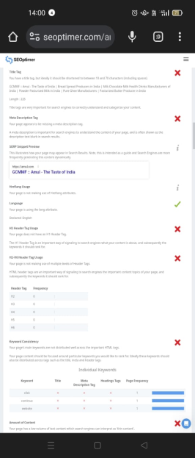
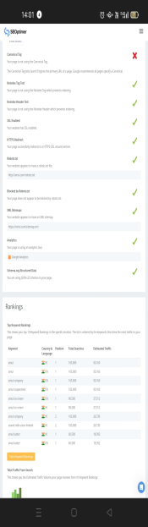
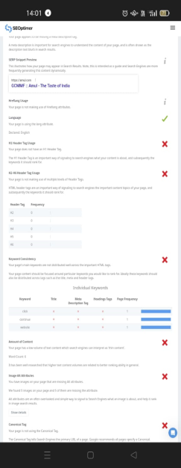
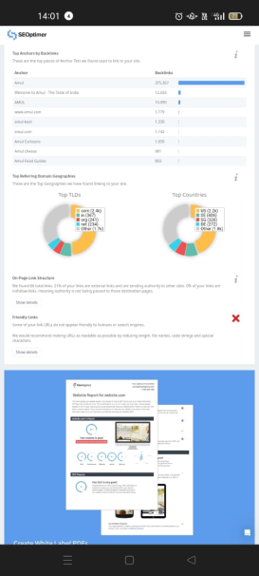
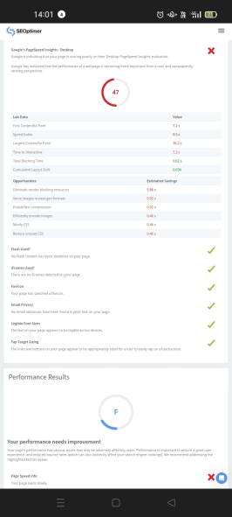
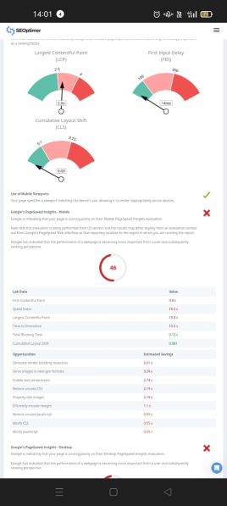
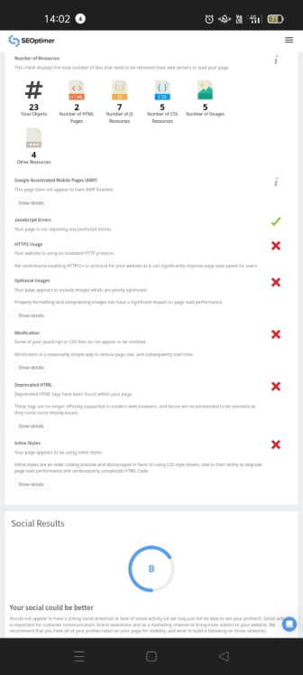
SEO and keyword research

Slide 18
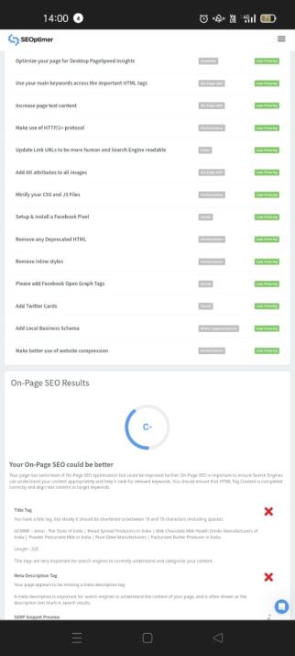

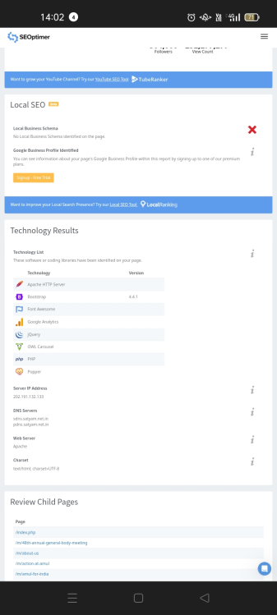
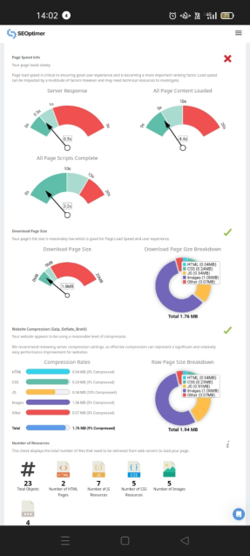

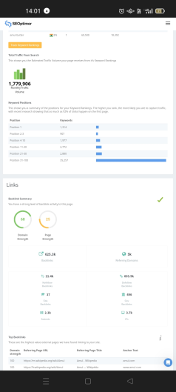
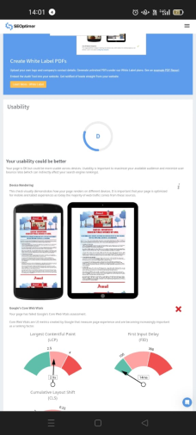
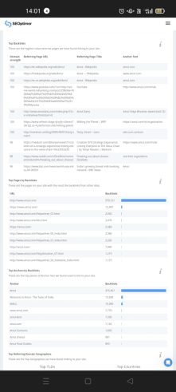

Slide 19
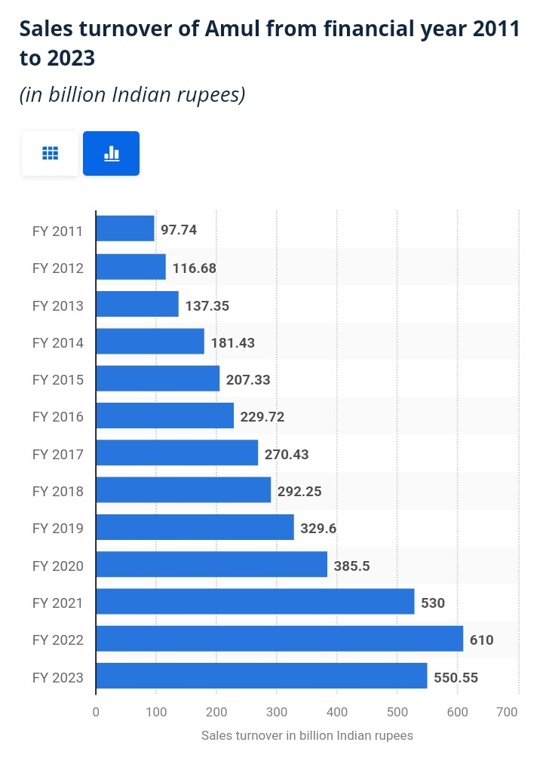
market status of brand
In ﬁnancial year 2023, Amul reported a sales turnover of over 550 billion Indian rupees. Anand Milk Union Limited (Amul) is one of the largest dairy companies in the world with an increasing growth rate since 2011.

Slide 20
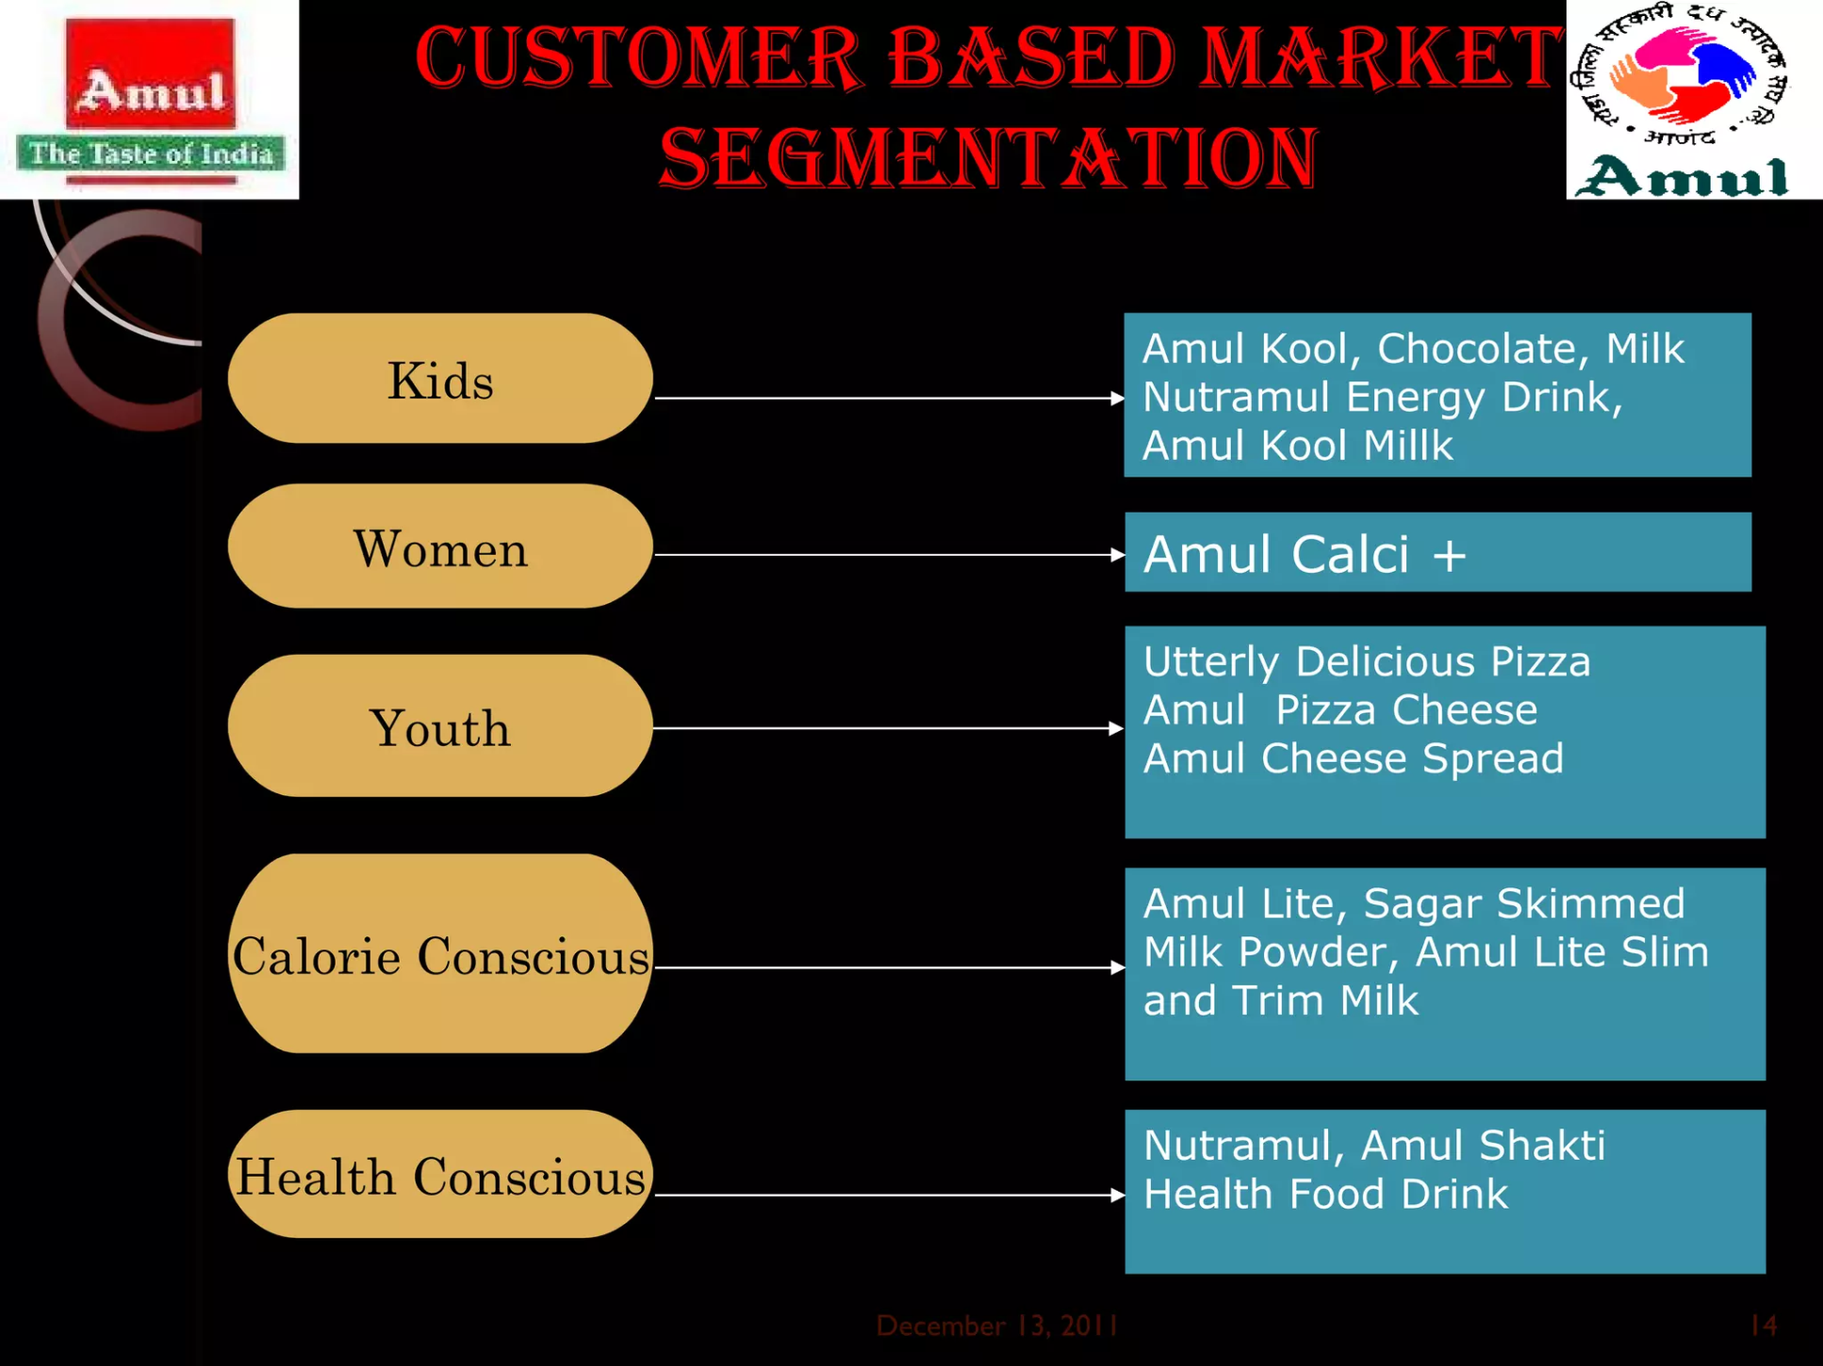
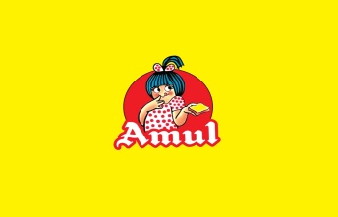

Slide 21
Brand curation strategies of amul
Iconic amul girl
Creative advertising
Quality dairy products
Wide product range
Strong distribution
Cooperative model
Social responsibility
innovation

Slide 22
Instagram story link
https://instagram.com/stories/food_court_456/3212586446538371127?utm_source=ig_story_item_share&igshid=NjZiM2M3MzIxNA==
https://instagram.com/stories/food_court_456/3212582574709057430?utm_source=ig_story_item_share&igshid=NjZiM2M3MzIxNA==

Slide 23

.
s4

